Slide 1
Battle of Neighborhoods
Capstone Project

Slide 2
Project Details
To Identify a location/Cluster in Hyderabad for putting up a new food joint
This project will be useful for new Entrepreneurs
It fetches and gives location information for prospective new food joint ventures

Slide 3
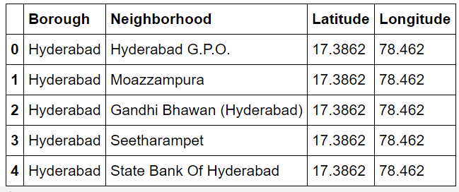
Data Collection and Exploration
Data Collected from Geonames and india.gov.in sources
Major Borough identified by correlating with District Data
Foursquare has been used to obtain venues from the latitude-longitude data obtained.

Slide 4
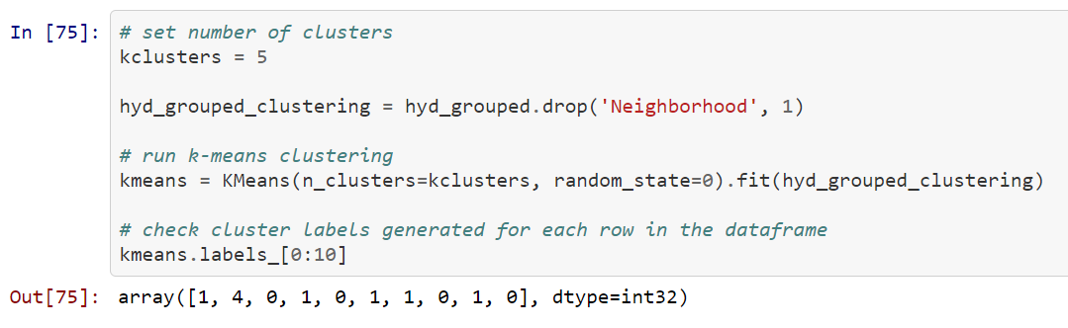
Model Selection
K- Means cluster algorithm has been used. dataset as it is expected to only cluster the data based on the commonality in the data set.
5 clusters data has been populated to understand similarity in the cluster
Foursquare has thrown results for top 10 venues
They are grouped and merged to see meaningful result

Slide 5
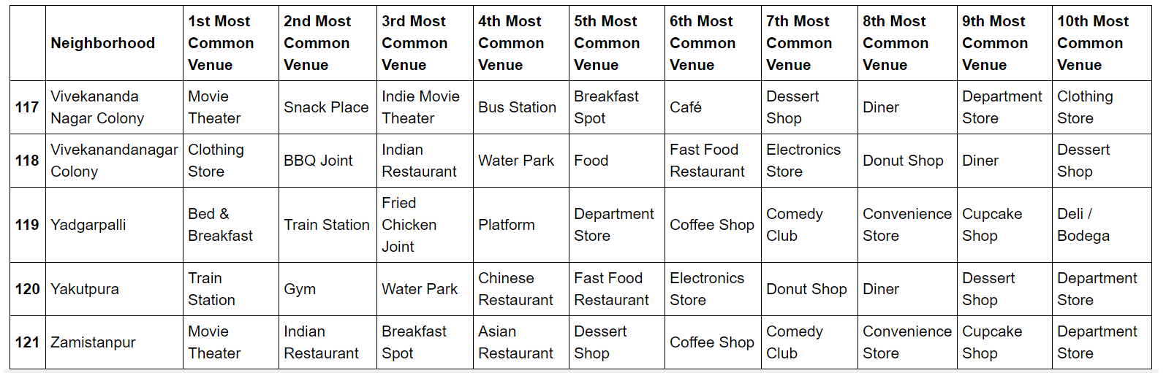
Result Analysis & Conclusion

Slide 6
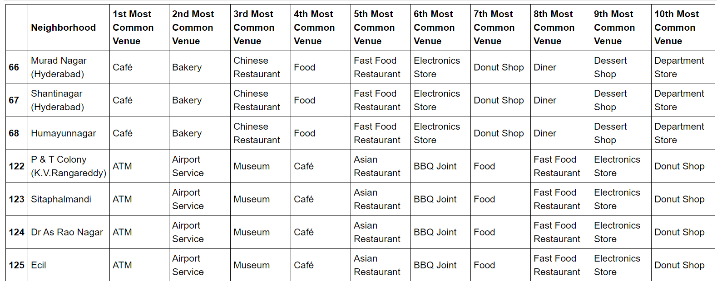
Result Analysis & Conclusion

